Slide 1
SOC Design Lab
Lab1 – Tool Installation
TAs

Slide 2
Objectives
In this lab, you will
Import the experimental tool development kit (including the Xilinx Vitis, GTKWave, RISC-V GCC Toolchains) into your virtual machine.
Run a simple case to verify the simulation and synthesis function.

Slide 3
Needed files
Vitis VM folder: (copy from TAs)
Experimental tool development kit zip files
User guide
Note: The unzip files have a size of over 200GB, please make sure you have enough space.
Verilog folder: (https://github.com/roo-nju/hkust-soc-lab/tree/main/Lab1/Verilog)
Design file
Simulation file
Test data

Slide 4

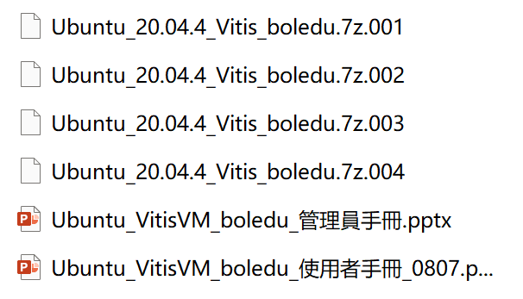
Import the experimental tool development kit to virtual machine
Refer to the user guide in the Vitis VM folder

Slide 5
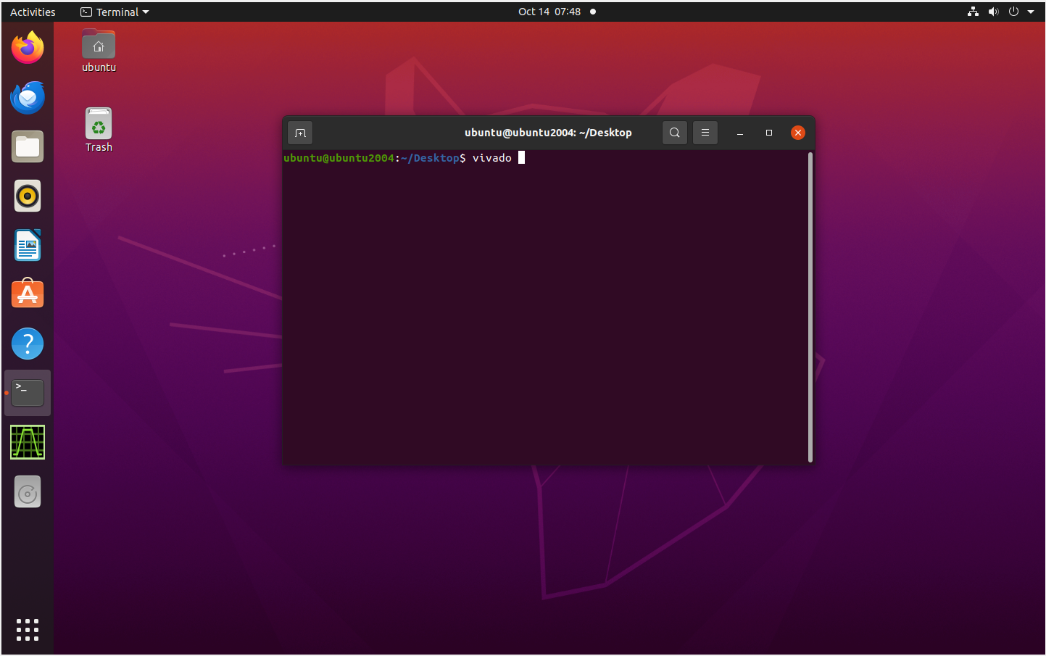
Run a simple case to verify the simulation and synthesis function
Create a new project
Open the vivado

Slide 6
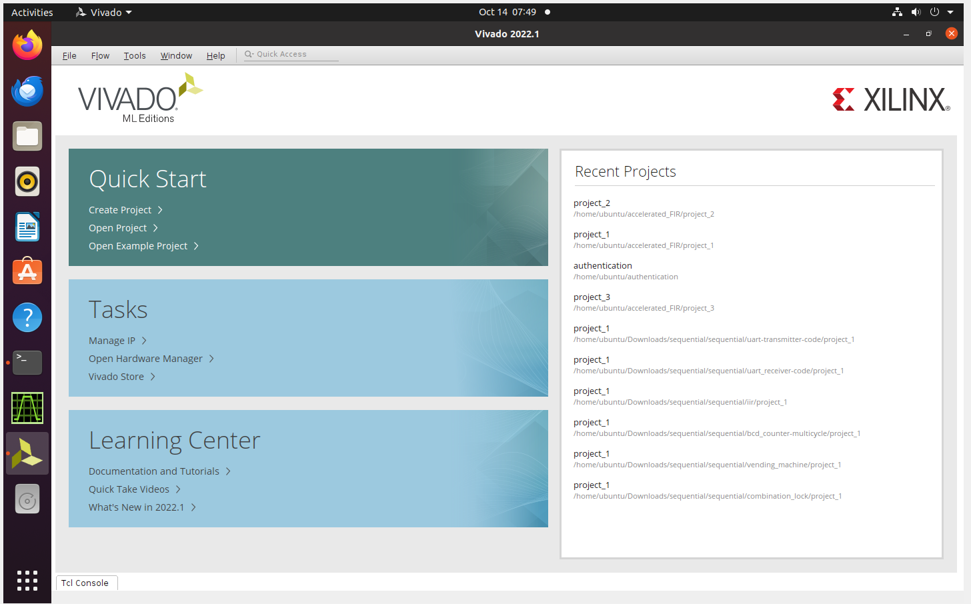
Run a simple case to verify the simulation and synthesis function
Create a new project
Create project

Slide 7
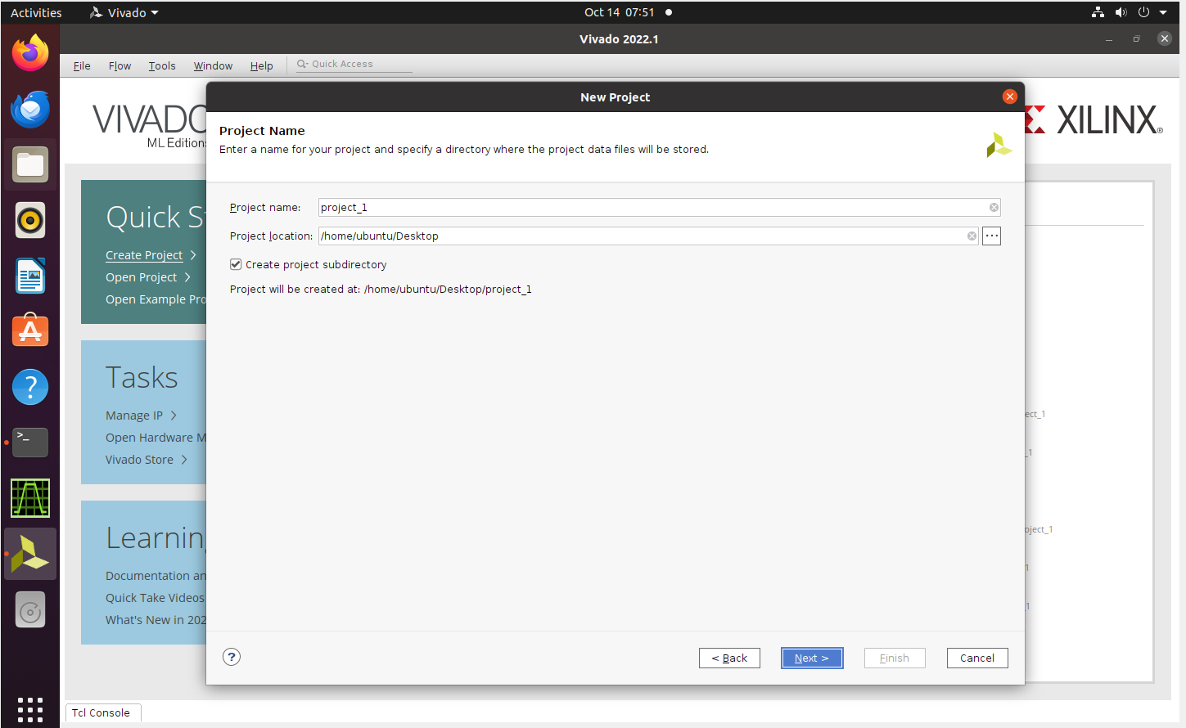
Run a simple case to verify the simulation and synthesis function
Create a new project
Create project

Slide 8
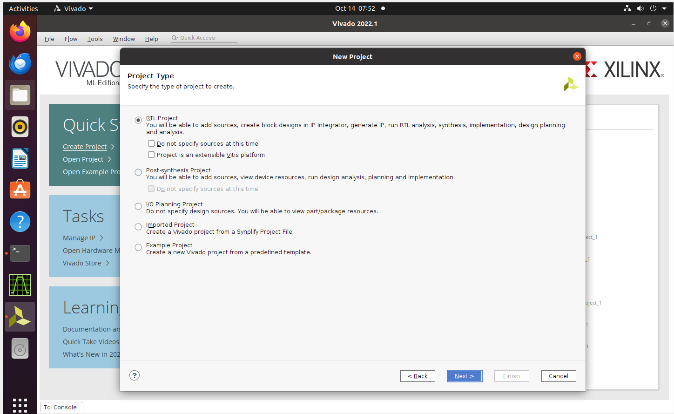
Run a simple case to verify the simulation and synthesis function
Create a new project
Select RTL project

Slide 9
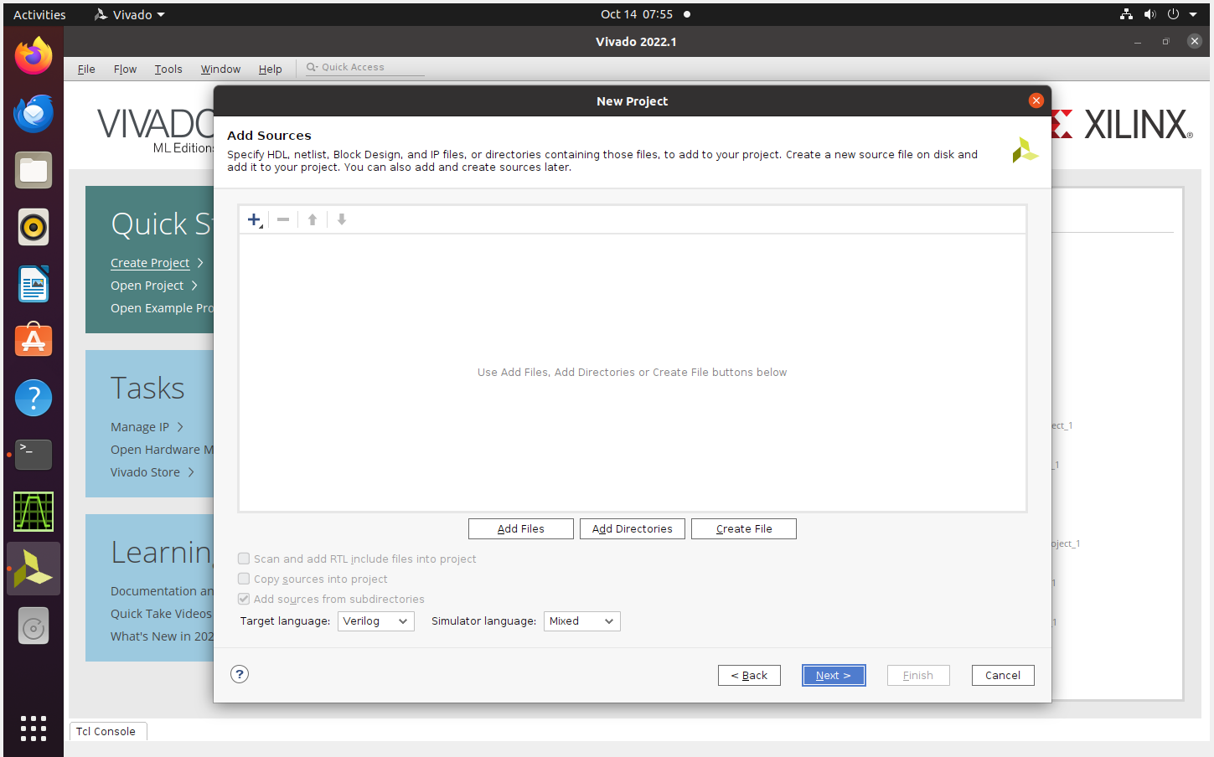
Run a simple case to verify the simulation and synthesis function
Create a new project
Add sources
Directly next step

Slide 10
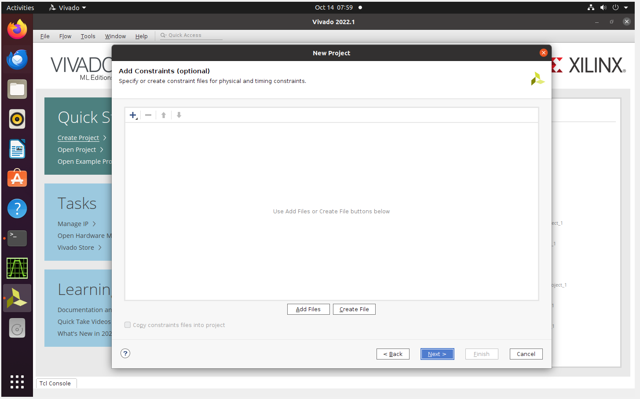
Run a simple case to verify the simulation and synthesis function
Create a new project
Add constraints
Directly next step

Slide 11

Run a simple case to verify the simulation and synthesis function
Create a new project
Select FPGA board: xc7z020clg400-1

Slide 12

Run a simple case to verify the simulation and synthesis function
Create a new project
Finish creating the project

Slide 13
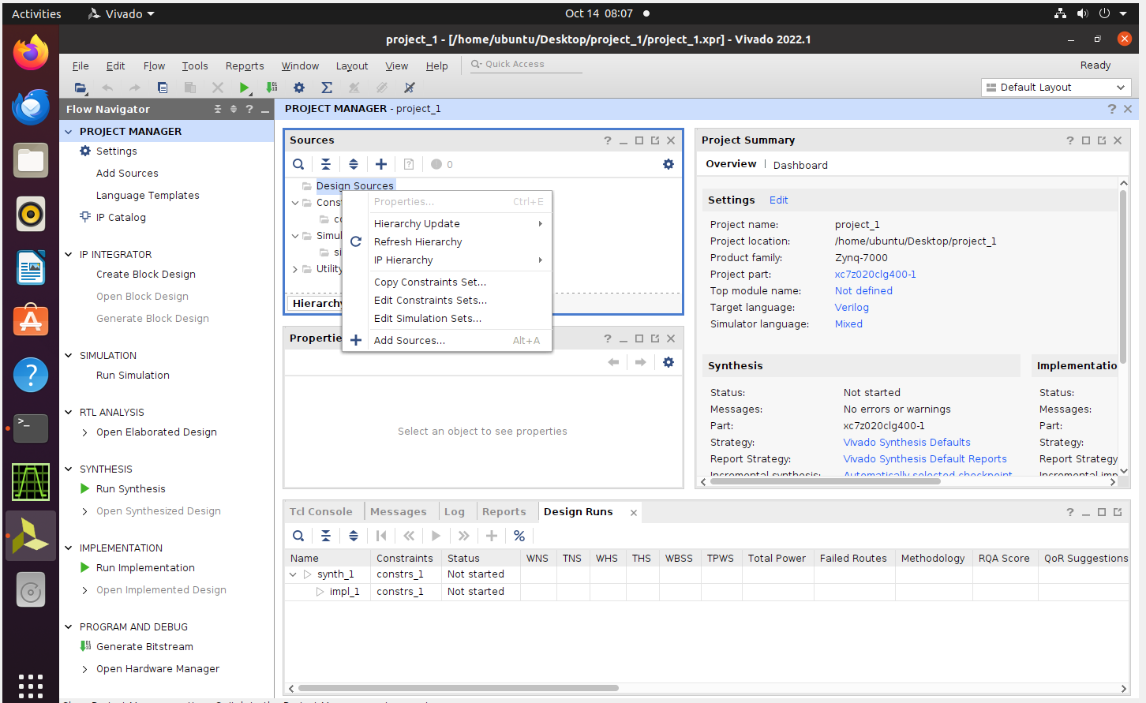
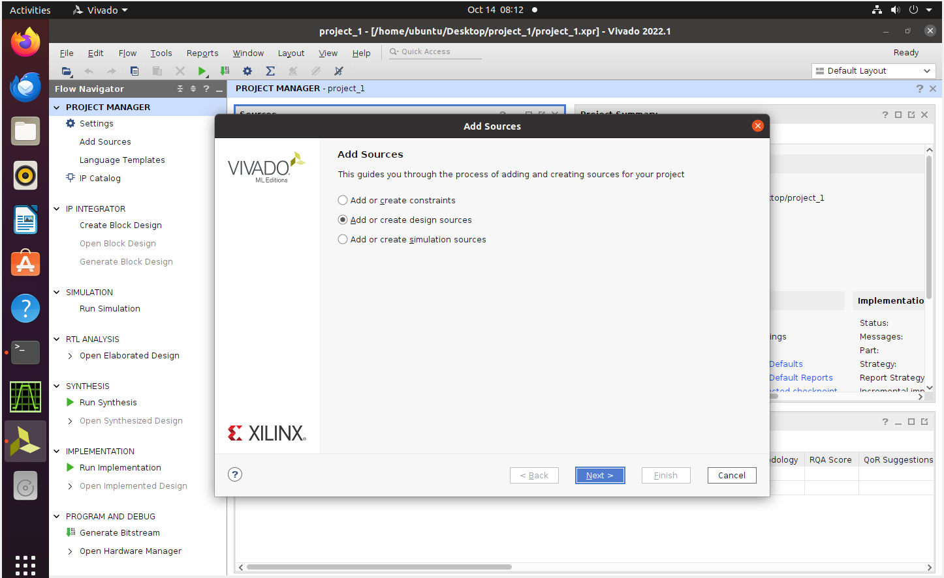
Run a simple case to verify the simulation and synthesis function
Add files
Add design sources

Slide 14
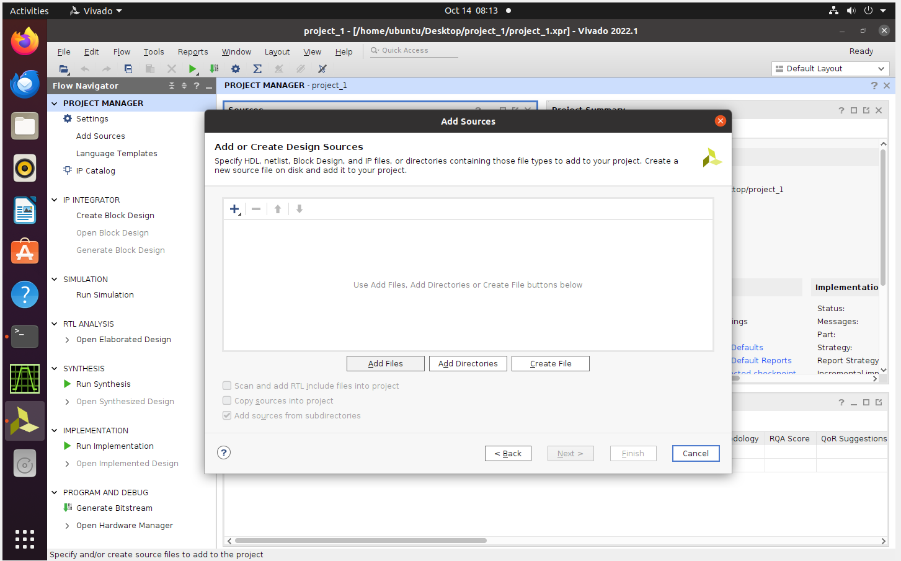
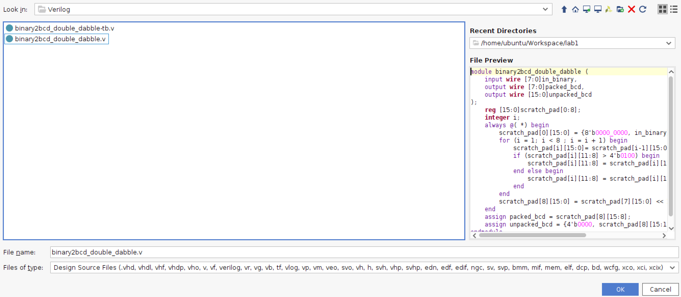
Run a simple case to verify the simulation and synthesis function
Add files
Add design sources (First copy the files from host to VM)

Slide 15
Run a simple case to verify the simulation and synthesis function
Add files
Add testbench

Slide 16

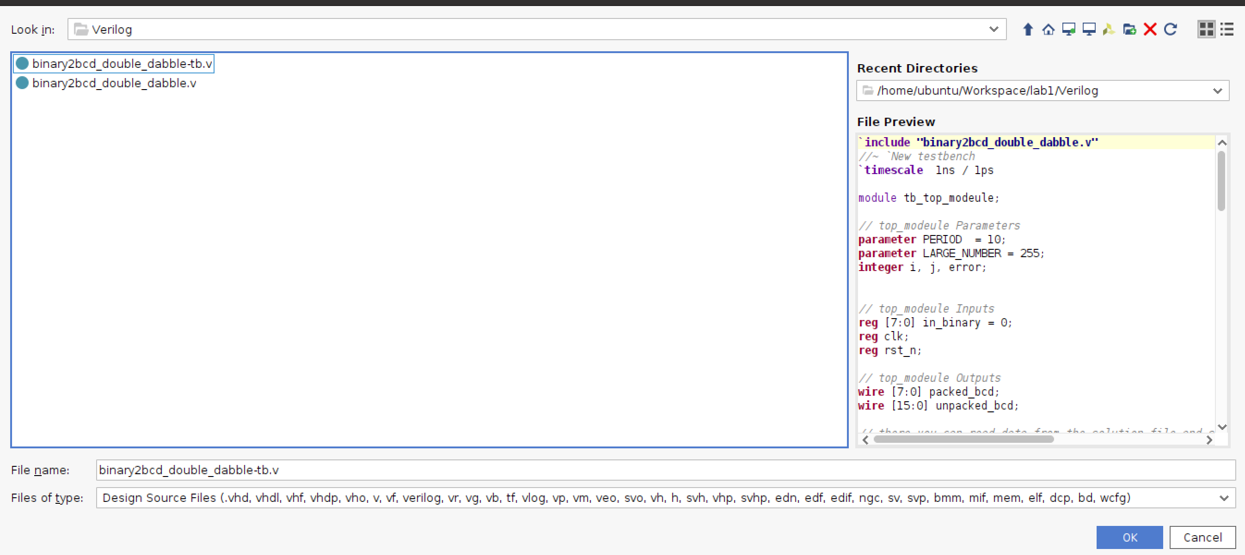
Run a simple case to verify the simulation and synthesis function
Add files
Add testbench

Slide 17
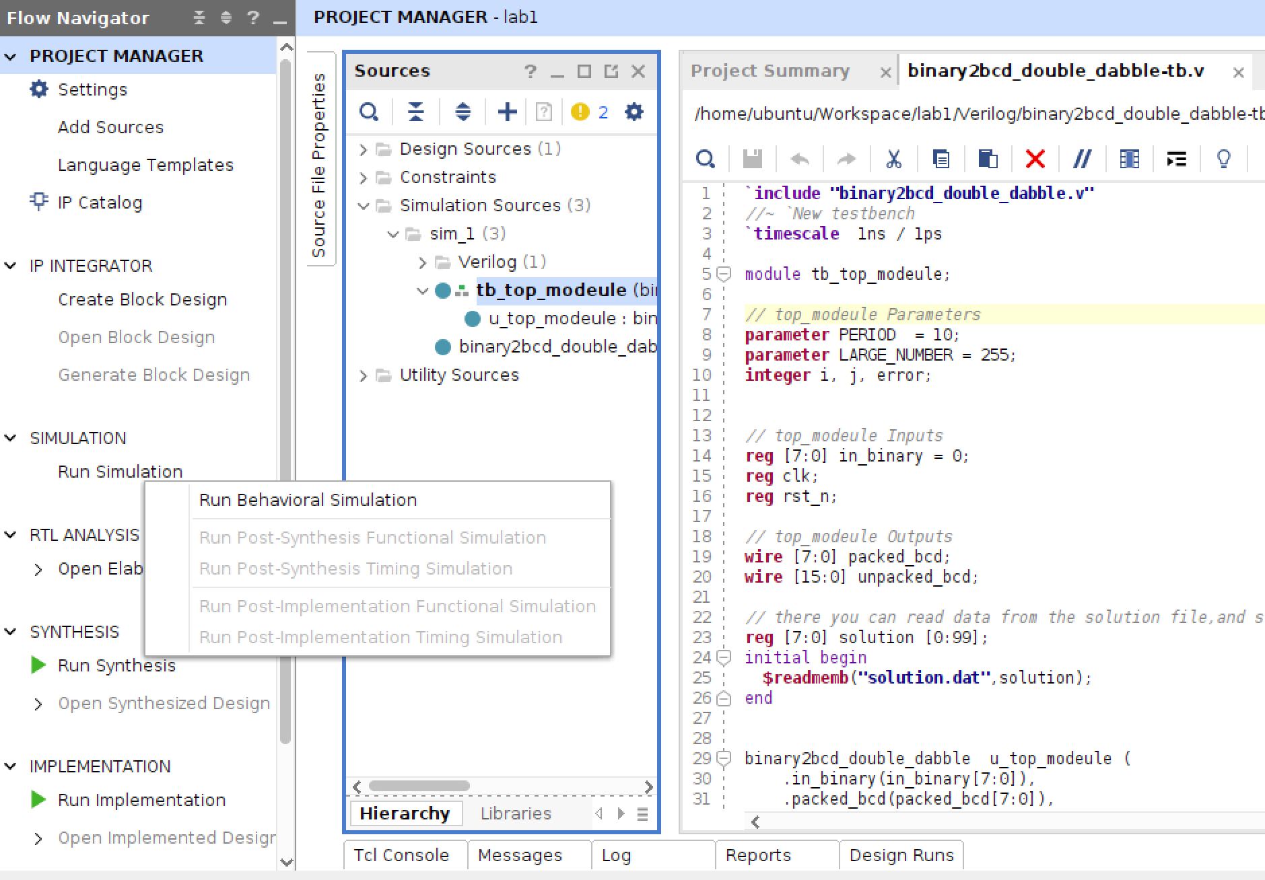
Run a simple case to verify the simulation and synthesis function
Run simulation
2
1
Modify the file path

Slide 18
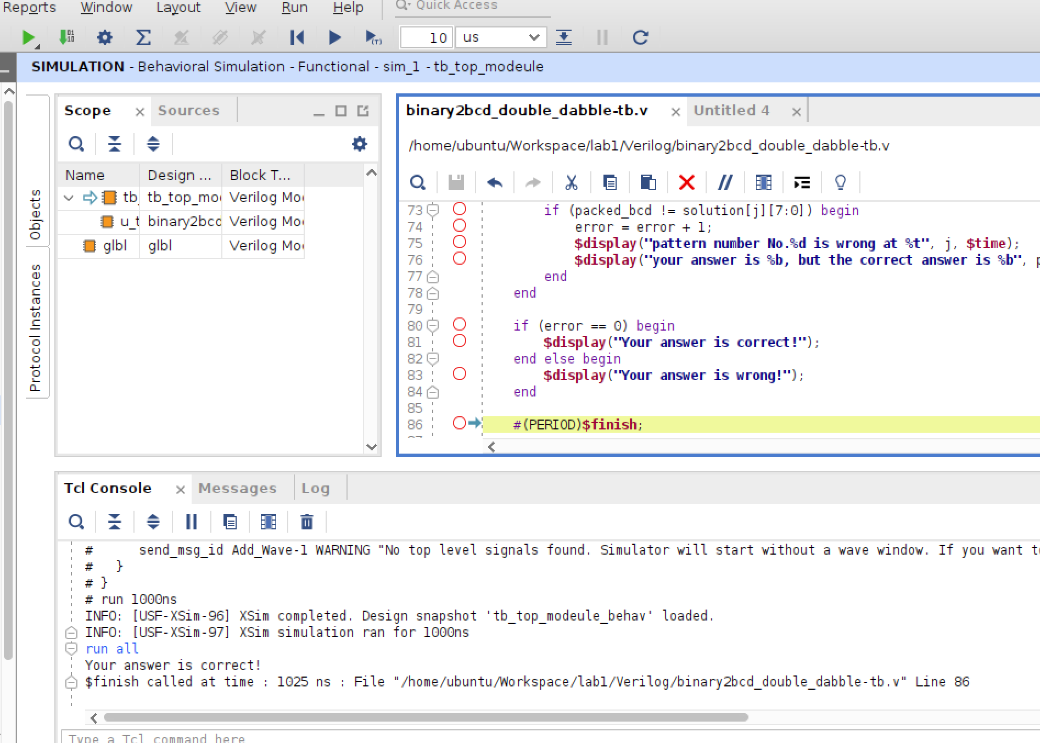
Run a simple case to verify the simulation and synthesis function
Run simulation
Simulation success!

Slide 19
Run a simple case to verify the simulation and synthesis function
Run synthesis
Create clock constraints

Slide 20
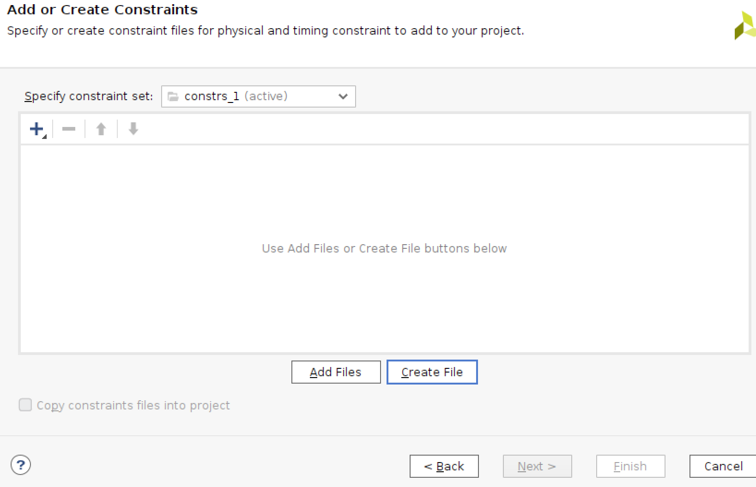
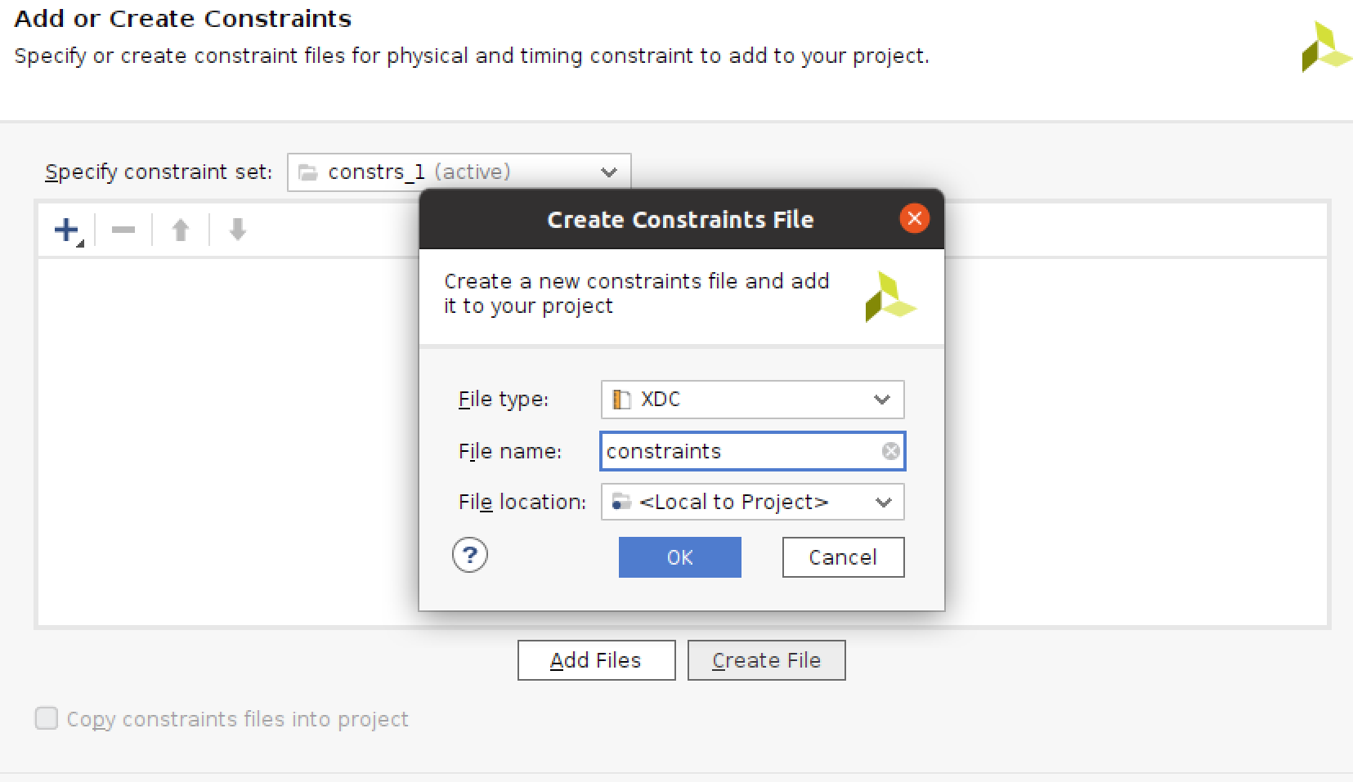
Run a simple case to verify the simulation and synthesis function
Run synthesis
Create clock constraints

Slide 21
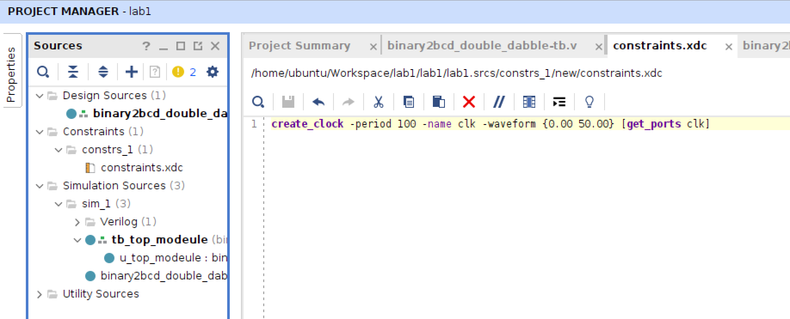
Run a simple case to verify the simulation and synthesis function
Run synthesis
Create clock constraints

Slide 22
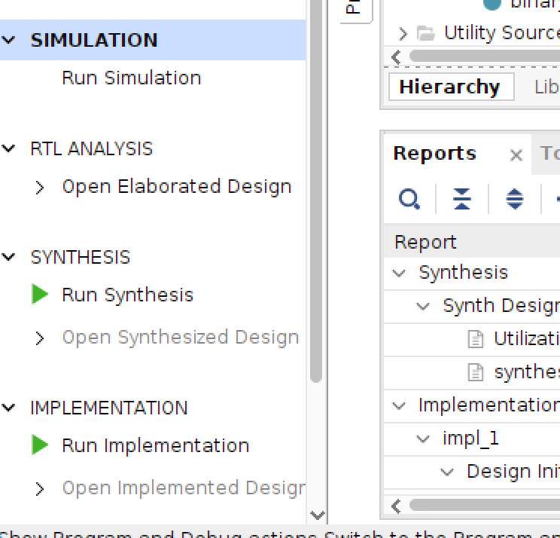
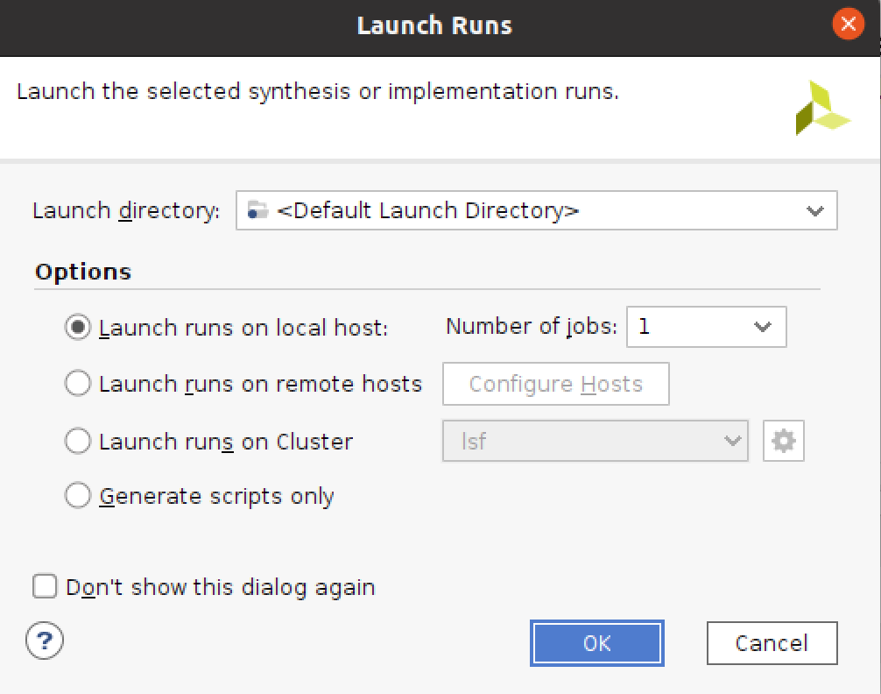
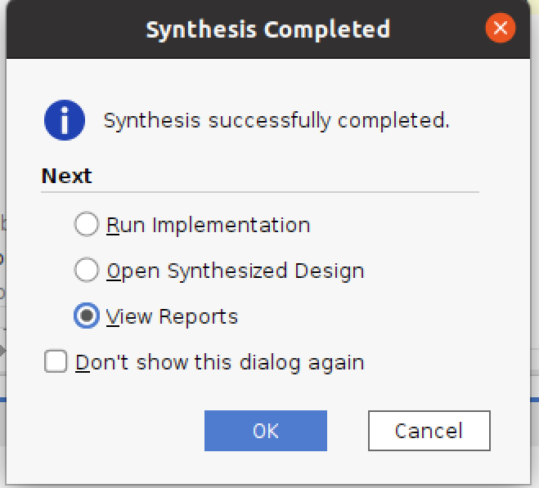
Run a simple case to verify the simulation and synthesis function
Run synthesis
Run synthesis (It takes some time…Please wait…)

Slide 23
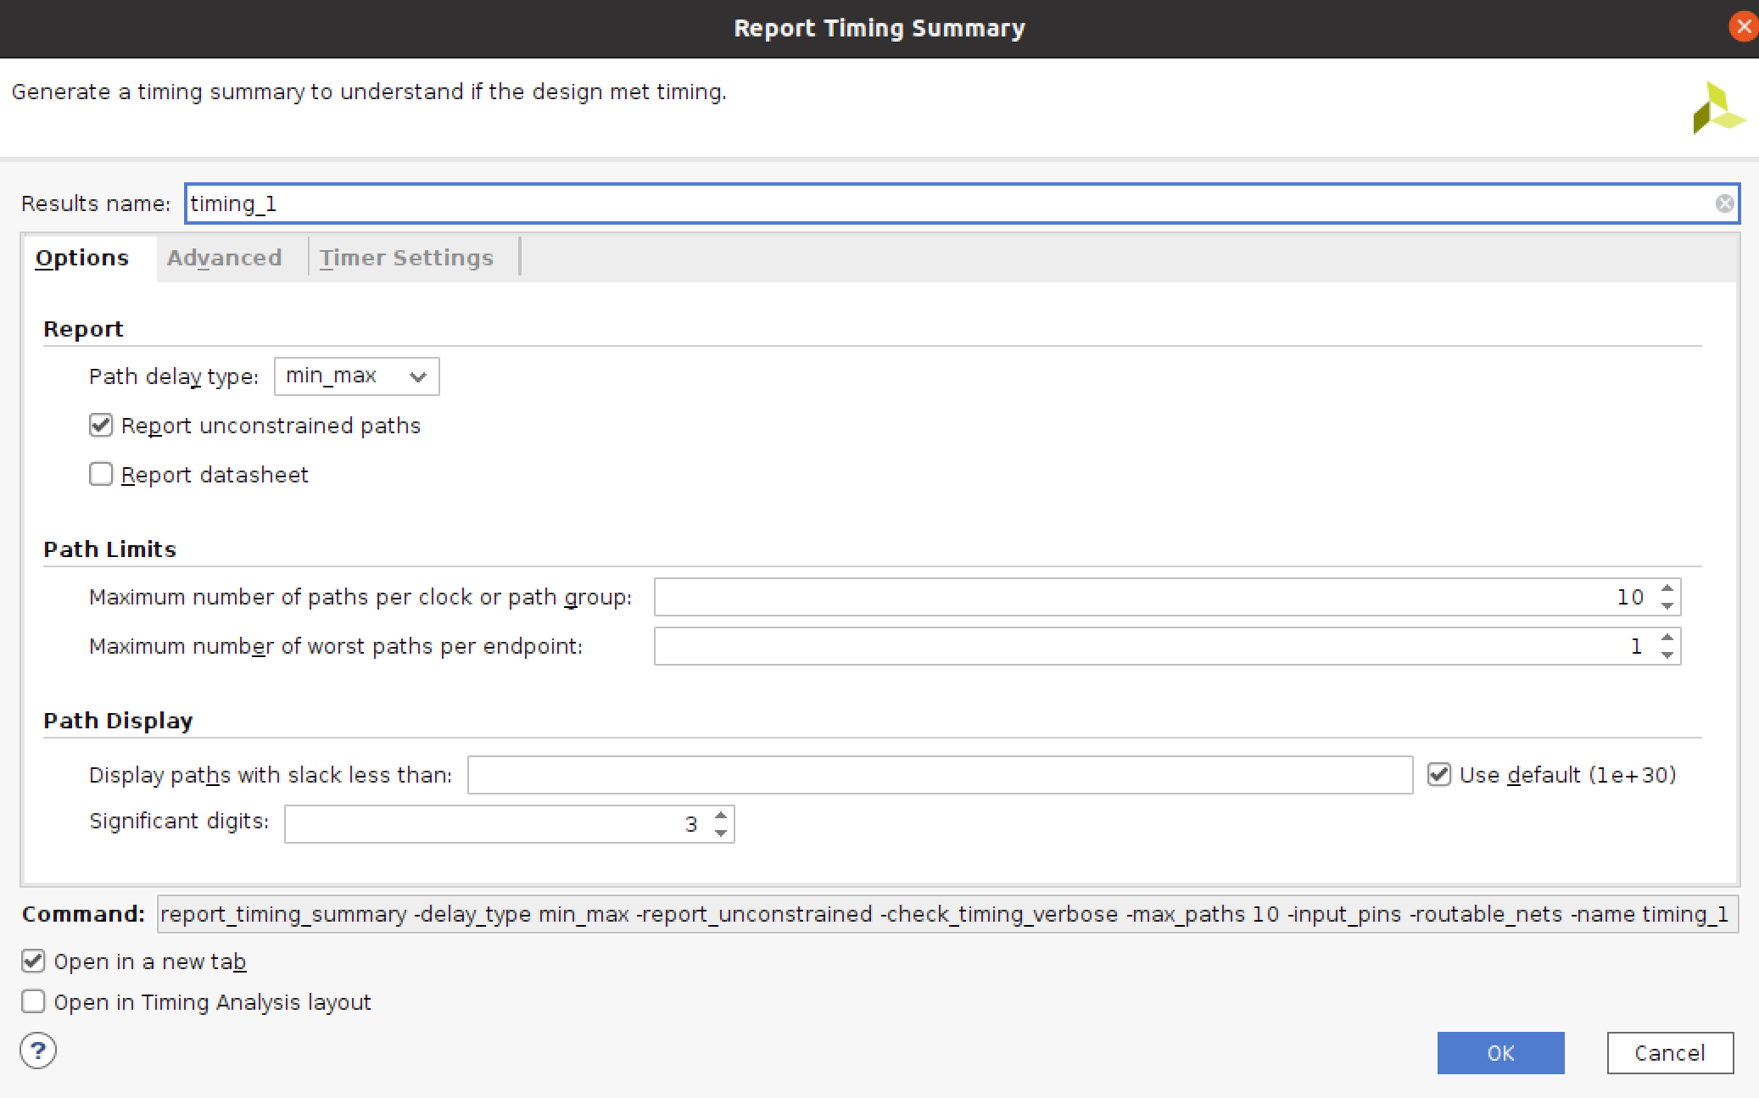
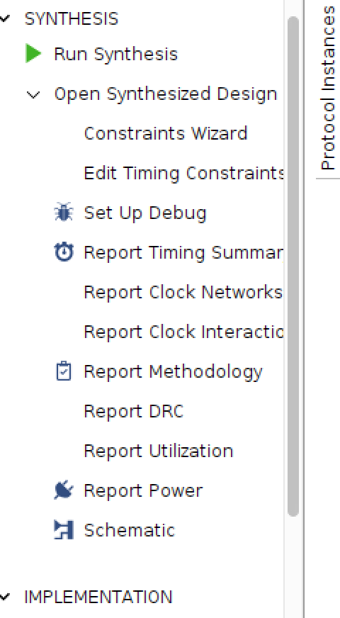
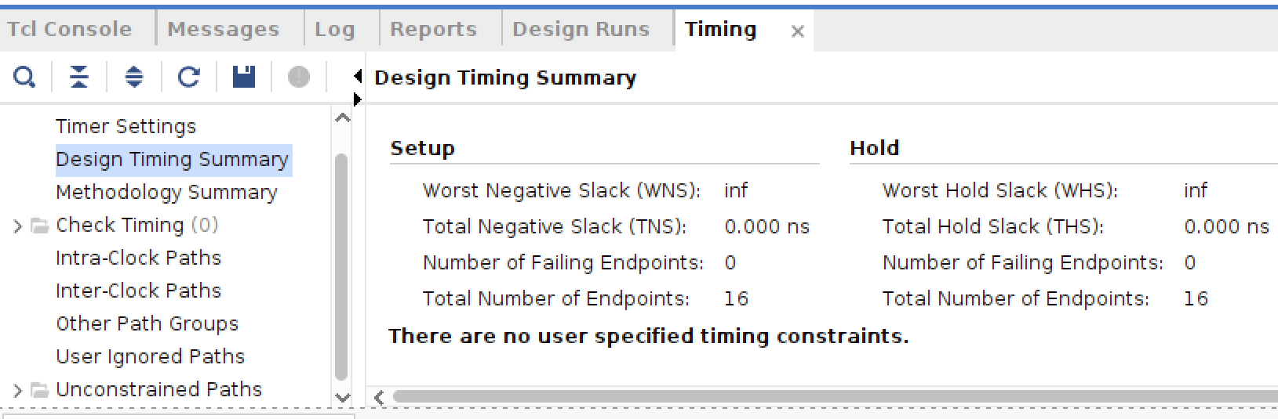
Run a simple case to verify the simulation and synthesis function
Run synthesis
Report timing
1
2
3 Output
Since no clk in the design file, output inf!

Slide 24
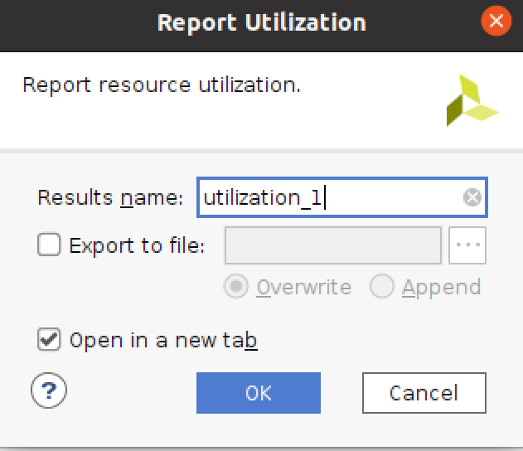
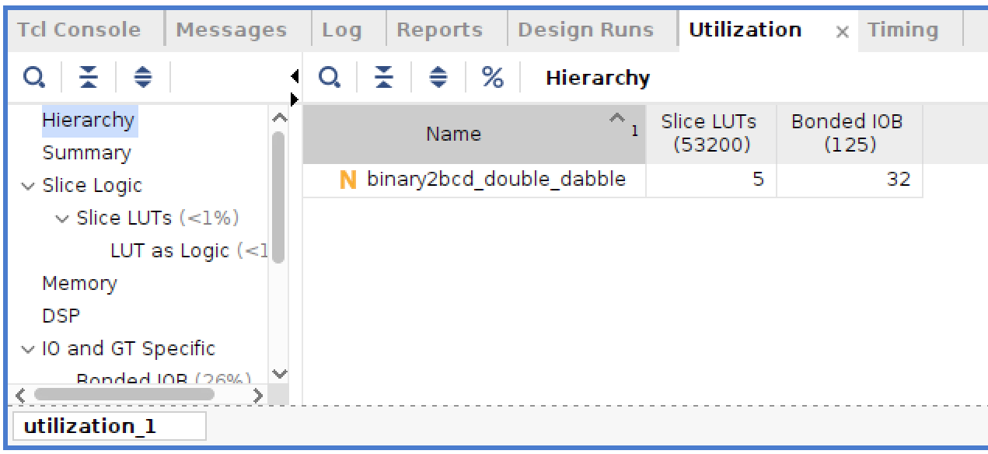
Run a simple case to verify the simulation and synthesis function
Run synthesis
Report utilization
2
3 Output
1
Synthesis success!

Slide 25
Submission
Submit to HackMD.
Simulation success screenshot
Synthesis success screenshot
Submit to GitHub.
Create your repository. In your lab1 folder, please include:
/src - design sources, .v, tb
/report - rtl simulation log, synthesis log/resource, timing report
Due Date: 23:59PM, Feb 9

